Slide 1
Shadow Mapping
Homework 3

Slide 2
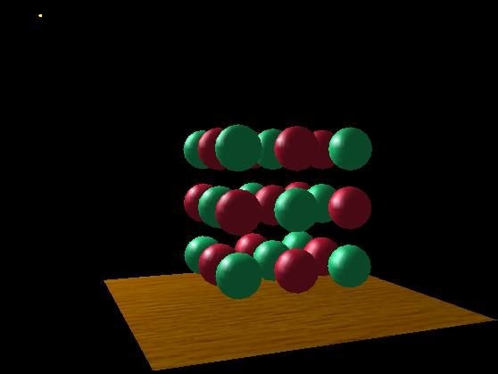
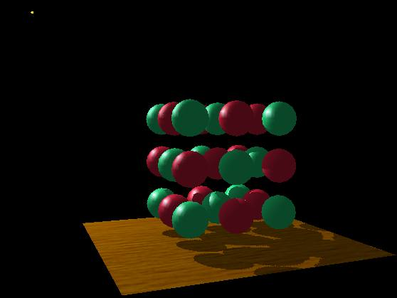

Shadow Mapping Algorithm
Aka, “Projected Texturing for Shadow Mapping”
Depth map from light’s point of view
is re-used as a texture and
re-projected into eye’s view to generate shadows
“what the light sees”
Notes:
https://www.slideshare.net/Mark_Kilgard/11texture
Other techniques : Shadow volumes, Light maps, Hybrid approaches.

Slide 3
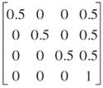
Shadow Mapping Algorithm
for each frame {
Construct the shadow map; // For a static scene, this can be outside the loop
Construct the shadow matrix = Q * projection * modelview; // For static lights, this can be outside the loop
In rendering the scene {
find out the shadow map coords of the vertex; // vertex shader
sh_coords = Q * projection * modelview * vertex;
sh_coords = sh_texture_matrix * vertex;
find out the shadow map coords of the fragment; // frag shader
automatically done by making sh_coords varying
if the fragment is in shadow, // frag shader
gl_FragColor = shadeFactor * gl_Color.rgb;
}
You can use either of these
Q matrix is used to transform coordinate from clip-space ([-1 1]^3) to texture-space ([0, 1]^3)

Slide 4
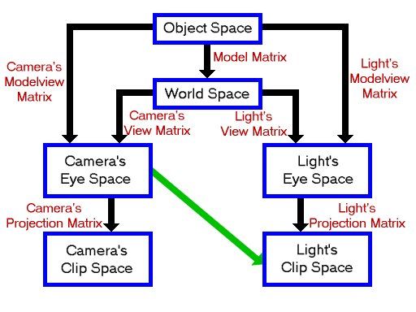
Shadow Mapping Algorithm
Camera screen space
Light screen space
Same vertex

Slide 5
Shadow Mapping Algorithm
for each frame {
Construct the shadow map; // For a static scene, this can be outside the loop
In rendering the scene {
vertex_shader{
out shadow_coord;
…
vertex_camera = Cam_Prj_mat*Cam_View_Mat*vertex_world;
shadow_coord =
Q*Lgt_Prj_mat*Lgt_Prj_Mat*vertex_world;
…
}
frag_shader {…}
}
}
Q:
Notes:
http://www.paulsprojects.net/tutorials/smt/smt.html

Slide 6
Shadow Mapping Algorithm
for each frame {
Construct the shadow map; // For a static scene, this can be outside the loop
In rendering the scene {
vertex_shader{…}
frag_shader{
uniform shadow_map;
in shadow_coord;
…
depth = shadow_map(Q*shadow_coord)
if(shadow_coord.z < depth ) visibility = 1
else visibility = 0
…
gl_FragColor = visibility * computed_shade.rgb;
}
}
Notes:
http://www.paulsprojects.net/tutorials/smt/smt.html

Slide 7
Shadow Mapping
Create the scene [20pts]
Create the light sources [15pts]
Toggle the light sources [15pts]
The Depth Overlay [30pts]
Shadow for moving object and light [20pts]
Highly recommend to use shader.
Due date : 5/29 11:55 pm

Slide 8
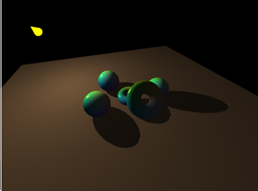
Create the Scene [20pts]
The scene should have at least one ground (plane) to cast the shadow.
The scene should have at least one model loaded from an obj file.
You are not allowed to use library to load this model. Create your own obj loader.
Example of obj model
http://graphics.stanford.edu/data/3Dscanrep/

Slide 9
Create/Toggle the Light sources
Create the light sources [15pts]
You should make at least two point light sources and at least one directional light sources.
The above means you need to create multiple shadow maps.
You can set position, direction, color and other attributes as you want.
Toggle the light sources [15pts]
For each light source bind a key to “turn on” and “turn off” the light source.
Let’s say, bind ‘1’ for the first light source. If you press ‘1’ light source should be turn off and press ‘1’ again light source should be turn on.

Slide 10
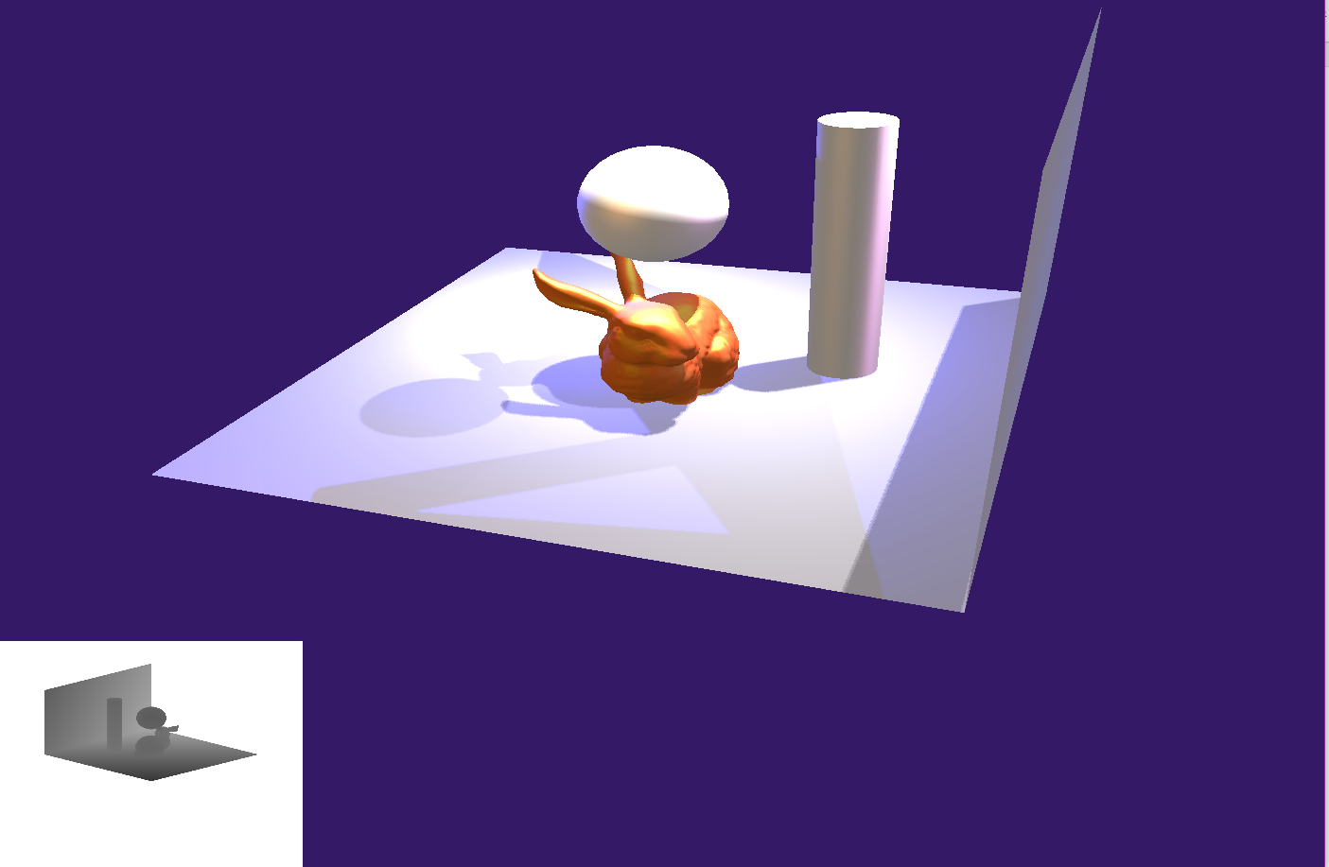
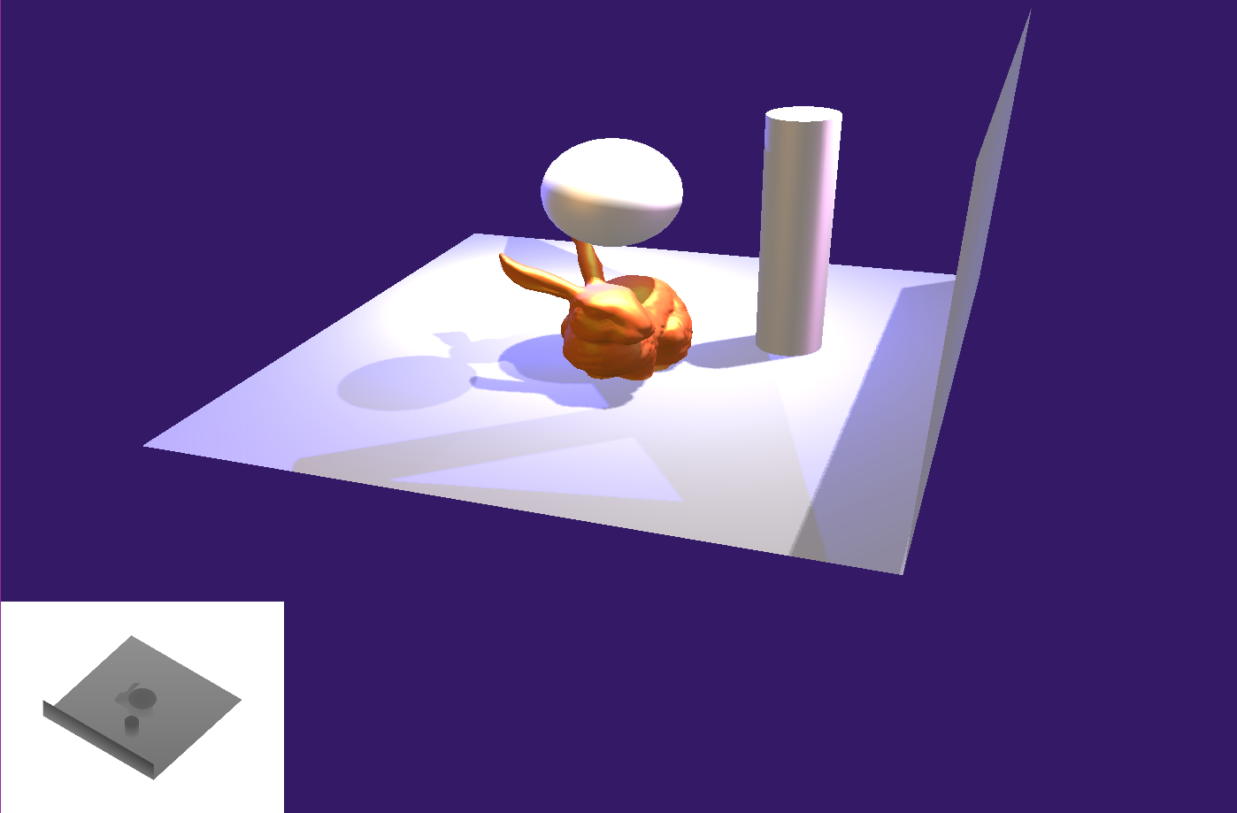

Depth Overlay [20pts]
Create overlay image which shows “depth image” from light source.
Bind ‘d’ to switch to the depth images of the other light sources.
For example, assumes that overlay shows the depth image of light source 1. After pressing ‘d’, it should show the depth image of light source 2.
This is important when you want to ‘debug’ your shadows.
By pressing ‘d’, overlay image should be changed as above figures.

Slide 11
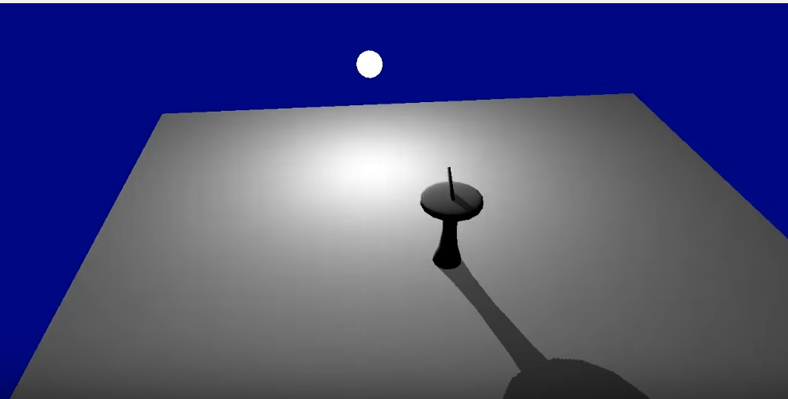
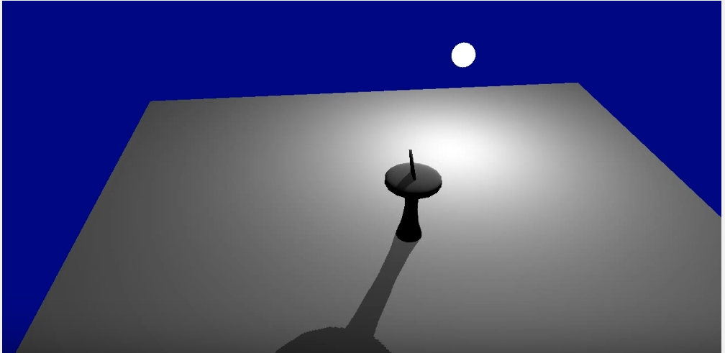
Shadow for moving object and light [20pts]
Each shadow map should be updated when the object/light changes the position.
When a certain light source moves, the shadow map corresponding to that light source should be updated.
When an object moves, all shadow maps should be updated.
You can move your object or light source with the picking function that you implemented in assignment 1. Or, you can just bind a key to move certain light/object.
You should implement at least one light source which can change the position and at least one object which can change the position.

Slide 12
Further Readings
http://www.cse.unsw.edu.au/~cs9018/readings/projective_texture_mapping.pdf
https://www.slideshare.net/Mark_Kilgard/11texture
https://www.slideshare.net/Mark_Kilgard/shadow-mappingwith-todays-opengl-hardware

